Slide 1
Progress Report 5 - Privacy
Lars Kivari and Mathias Masasabi
7/1/2013

Slide 2
In this presentation, we will discuss:
GM OnStar
Further discussion on pinpointability, traceability, trackability, etc.
hak5 Pineapple Mark IV
Comparison:
FBI Stingray
Wifi Pineapple
Standards
SAE J2735, SAE J2945, IEEE 1609.2, WSMP
EPIC
Terminology and Concepts pertaining to VANET Privacy

Slide 3
GM OnStar
Five Concepts:
Linkability
Traceability
Where has Vehicle X been (Location History/Past)?
Trackability
Where is Vehicle X currently and what path is it taking (Present)?
Big Brother
Pinpointability

Slide 4
GM OnStar
Threat Examples:
Pinpointability-
If a person regularly carried their smartphone while driving their vehicle equipped with OnStar, the signals from the phone would give an adversary the ability to pinpoint the driver. (REMOTE MOBILE APP)
At the time of an accident, OnStar is made aware of the location of the vehicle. It is pinpointed. (AUTOMATIC CRASH RESPONSE)
Traceability-
Similar to the method that an adversary could trace a vehicle regarding the hands-free calling feature, an attacker could find out which cell phone towers the smartphone used to show where the vehicle had been or just simply follow the signals the smartphone was emitting. (REMOTE MOBILE APP)
According to the OnStar website, if a vehicle used turn-by-turn navigation, their location history would be able to be traced back. (Turn-By-Turn Navigation)

Slide 5
GM OnStar
Threat Examples:
Big Brother:
In the case of a stolen vehicle, the authorities are then informed as they work in partnership with OnStar. This could open the door for the government to get more involved with people’s personal lives, hence acting as a ‘big brother’. (STOLEN VEHICLE ASSISTANCE)
If the government was given access to the location history of the vehicles connected to OnStar (since it is stored), they could then manipulate the data in many different ways. (TURN-BY-TURN NAVIGATION)

Slide 6
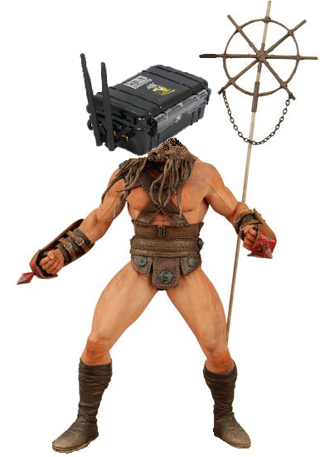
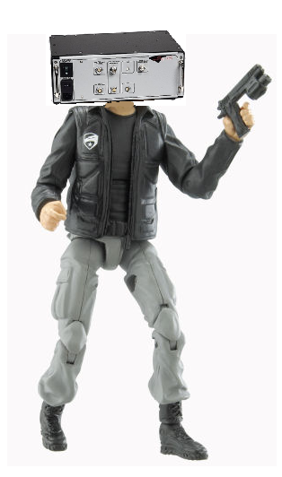
Comparison
FBI
Stingray
Wifi Pineapple

Slide 7
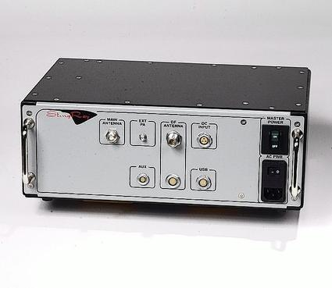
FBI Stingray
Basic Info:
Intercept/Impersonate cellular communication
Acts as a cell tower
Acts only passively for eavesdropping
“The FBI claims the device is designed only to grab information like "dialing, routing and address" data as part of a suspect's routine communication. However, they can't use it to precision-target, which means Stingray is also collecting data on innocent people."
Source

Slide 8
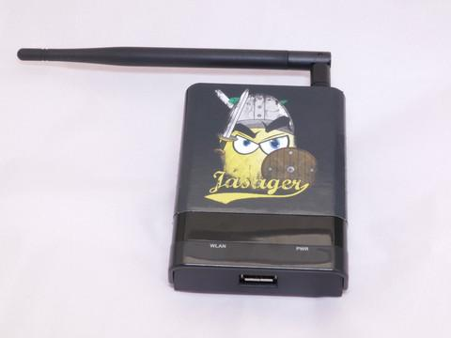
Wifi Pineapple
Basic Info:
Deceives devices into thinking they are connected to a legitimate internet source when they are actually connected to the Pineapple.
Can be used in both a passive and active manner (can eavesdrop and send malicious packages).
Available to the public for $99.
Technical Specifications

Slide 9
Comparing Stingray and Pineapple
Both can be used to invade someone's privacy
Active (Pineapple) and Passive (Stingray & Pineapple)
Stingray is government regulated whereas Pineapple can be publically bought.
Stingray is used as a way to investigate/probe other individual's information whereas Pineapple is used many times as a teaching tool by different agencies and companies (simulate attacks).

Slide 10
Standards......
Standard Description Resource
SAE: J22735 Dedicated Short Range Communications (DSRC) Message Set Dictionary. SAE: J2945.1 Dedicated Short Range Communication (DSRC) Minimum Performance Requirements | This Standard therefore specifies the definitive message structure and provides sufficient background information. For example, J2945-1 represents Basic Safety Message communication minimum performance requirements. | http://standards.sae.org/j2735_200911/ http://standards.sae.org/wip/j2945/

Slide 11
Standards.....
Standard Description Source
IEEE: 1609.2 IEEE Standard for Wireless Access in Vehicular Environment- Security Services for Applications and Management Messages | Secure message formats and processing for use by Wireless Access in Vehicular Environments (WAVE) devices, including methods to secure WAVE management messages and methods to secure application messages are defined in this standard. It also describes administrative functions necessary to support the core security functions. | http://standards.ieee.org/findstds/standard/1609.2-2013.html
IEEE: 1609.3 IEEE Standard for Wireless Access In Vehicular Environment (WAVE) Networking Service | Wireless Access in Vehicular Environments (WAVE) Networking Services provides services to WAVE devices and systems. Layers 3 and 4 of the open system interconnect (OSI) model and the Internet Protocol (IP), User Datagram Protocol (UDP), and Transmission Control Protocol (TCP) elements of the Internet model are represented. Management and data services within WAVE devices are provided. | http://standards.ieee.org/findstds/standard/1609.3-2010.html

Slide 12
EPIC......
SOURCE | DESCRIPTION | PROS AND CONS
http://epic.org/privacy/reidentification/#intro | Re-Identification- a process where confidential information/ data is paired with the owner of that information. | Problem: De-identified data such as hospital records, financial statements, prescription meds, and etc are at risk, to be put into the wrong hands of crimes. EASILY ACCESSIBLE. Solution: Any identifying mechanism should change IDs every so often whether it be minutes to hours to prevent traceability. Vanets: This relates to VANETS because re-identification is key to maintaining privacy. The pseudo ID of the car can only be matched with the owner and no other outside source.

Slide 13
EPIC.....
Source Description Cons/Solution
http://epic.org/privacy/reidentification/#intro | Smart Grid- up and coming technologies for public use to help service and reduce dependency of electricity consumption. Problems/ VANETS: Identity Theft Determine Personal Behavior Patterns Determine Specific Appliances Used Perform Real-Time Surveillance Reveal Activities Through Residual Data Targeted Home | Provide Accidental Invasions pon Inaccurate Data Profiling Unwanted Publicity and Embarrassment Tracking Behavior Of Renters/Leasers Behavior Tracking (possible combination with Personal Behavior Patterns) Public Aggregated Searches Revealing Individual Behavior Provide Accidental Invasions Solution: Implement anti- hacking software so none of the system can be penetrated.

Slide 14
EPIC.......
Source Description Issues/ Solution
http://epic.org/privacy/reidentification/#intro | Location Privacy- Maintaining total anonymity as to your current location or to where you are going. | Issues- Tracking technologies such as GPS trackers, and cell phones being enabled to track select persons, without them rightfully knowing so. This is a violation of the person's Fourth Amendment Right (search and seizure). Solution- Pass legislation that prohibits law enforcement to track persons of interest without a judge issued warrant. Furthermore, people should turn off their GPS locators on their cell phones.

Slide 15
EPIC.......
Source Description Problem/Fact/Sol..
http://epic.org/privacy/reidentification/#intro | Freedom of Information Act Work on the National Security Agency's Warrantless Surveillance Program- Being able to listen in and or see correspondence without out an issued warrant. | Problem: It is a violation of the 4th amendment. It is intrusive. Hackers and Terrorists will find more illegal and lethal ways to communicate or send correspondents. BIG BROTHER Solution: UNDECIDED FACT: President Bush secretly issued an executive order in 2002 authorizing the National Security Agency to conduct warrantless surveillance of international telephone and Internet communications on American soil.

Slide 16
New Info on Stingray
A secretive cell phone spy device known as StingRay, intended to fight terrorism, was used in far more routine LAPD criminal investigations 21 times in a four-month period during 2012, apparently without the courts' knowledge that the technology probes the lives of non-suspects who happen to be in the same neighborhood as suspected terrorists. (Jon Campbell)
This information indicates that Stingray is not just used by federal law enforcement, but for local law enforcement as well. If local or even state law enforcement have access to Stingray, the system may find its way into civil possession. Furthermore, I believe this device being used without considerable discretion intrudes on 4th amendment privacy clauses. Stated in previous slides Pineapple can be publicly bought for educational purposes, on the contrary Stingray is not available for public purchase nor use.

Slide 17
TRACEABILITY VS. TRACKABILITY
Traceability- A visible mark or trail, such as a footprint, made or left by the passage of a person or thing.
Ex: If you were looking for your dog, you follow his footprint trail to locate him.
Trackability-Follow the course or trail of (someone or something), typically in order to find them or note their location at various points.
Ex: For example if your car had onstar and it was stolen, people could track it every move with precision.

