Slide 1
Progress Report 4: Privacy
Lars and Mathias
6/24/2013

Slide 2
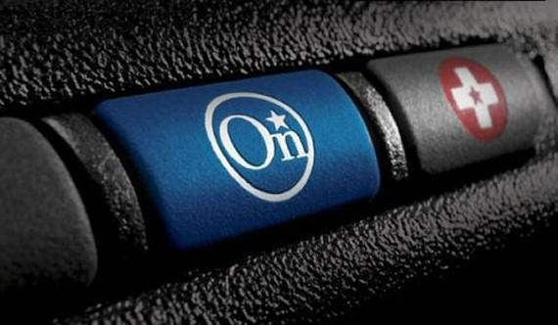
Looking Closer at...
GM OnStar
What features does GM OnStar offer?
How could these features violate:
Unlinkability
Untrackability
Privacy
FBI Stingray Mechanism
Basic features of Stingray
Investigating its intrusiveness and the constitutionality of the device.
EPIC.org

Slide 3
“A Connecticut car rental firm tried to punish customers who exceeded the speed limit several years ago by using a hidden GPS-based tracking system. The courts eventually ruled against the American Rental company’s practice.”
NBC News
Source

Slide 4
GM OnStar-
Nine Features offered by OnStar:
1. Automatic Crash Response
2. Emergency Services
3. Hands-Free Calling
4. Remotelink Mobile App
5. Stolen Vehicle Assistance
6. Roadside Assistance
7. Remote Services
8. Vehicle Diagnostics
9. Turn-by-Turn Navigation

Slide 5
Features in OnStar Discussed:
Automatic Crash Response:
Locating the vehicle, that is connected to OnStar, automatically when involved in an accident.
Emergency Services:
This service can be used for any emergency that may happen to the driver, passengers or even the people around them whether it be medical, amber alerts or other types of emergencies that require immediate attention.
Hands-Free Calling:
Calling another cellular number through the on board system by means of a number assigned to the driver upon subscription to OnStar.

Slide 6
OnStar Features Cont...
Remotelink Mobile App:
The remotelink mobile app gives you access to certain features of your vehicle through an app that can be downloaded on one’s smartphone. You can check oil/fuel levels, lock/unlock doors, view hands-free calling info, etc. Each time this app is accessed, location information is collected.
Stolen Vehicle Assistance:
In the event that a vehicle (that is connected to OnStar) is stolen, the police can be contacted by the owner of the car. Once the police are contacted and the car has been located (due to OnStar location services) the vehicle can be remotely controlled to slow down and eventually stop.
Roadside Assistance:
This service can be used if your vehicle gets a flat tire, runs out of gas, etc. for vehicle related issues. Using the GPS locating devices, your vehicle can be pinpointed for assistance to be directed to you.

Slide 7
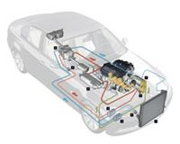
OnStar Features Cont...
Remote Services:
This service allows the vehicle owner to unlock their vehicle if they accidentally lock their keys inside the vehicle. By contacting OnStar and verifying as the owner, OnStar can send a signal to the vehicle to unlock the doors. This feature can also be used if a person can’t find their vehicle, say, in a parking lot. A signal can be sent to flash the vehicle lights and activate the horn.
Vehicle Diagnostics:
A diagnostic report is sent to the owners of the vehicles on a monthly basis checking on the various systems in the car to make sure they are in working order.
Turn-by-Turn Navigation:
Basic GPS directions to any given point. Location history is stored.

Slide 8
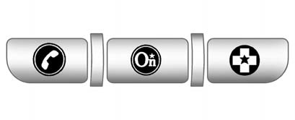
So how do these features relate to unlinkability, untrackability, and privacy?
Examples:
Emergency Services-
Unlinkability: When an emergency occurs and the driver contacts OnStar, personal information pertaining to the customer is already on file with OnStar. This would allow the car to be linked to the identity of the person.
Remote Services-
Untrackability: If a person used their smartphone to use these remote services, they could be tracked by their phone or their vehicle.
Turn-By-Turn Navigation-
Privacy: The location/destinations of customers is saved. Location privacy could definitely be breached here.

Slide 9
STINGRAY DESCRIPTION
Stingray is a recording mechanism that the Federal Bureau of Investigation uses to listen in on phone conversations. Stingray also has the ability to assume the capabilities of telephone towers, which can intercept incoming and outgoing call from anyone. This undercover system has caused a lot of controversy in regards to the constitutionality and legality of it uses and functions.

Slide 10
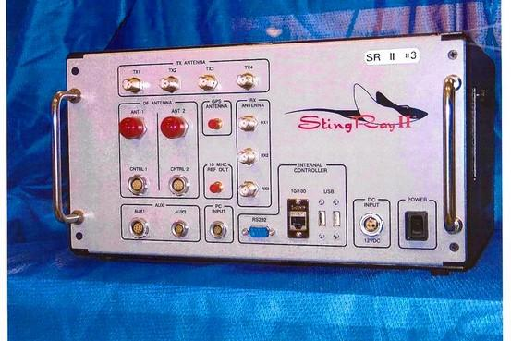
STINGRAY

Slide 11
FEATURES OF STINGRAY
Stingray | Description | Features
Enter the FBI’s ‘Stingray’ Phone Tracker, Able to Locate Cell Phones Even When Not In Use. http://strata.oreilly.com/2013/04/fbi-stingray-irs-email-liquid-robotics-data-driven-campaigns.html | For more than a year, federal authorities pursued a man they called simply “the Hacker.” Only after using a little known cellphone-tracking device — a stingray — were they able to zero in on a California home and make the arrest. | Stingrays are designed to locate a mobile phone even when it’s not being used to make a call. Stingrays linking to other phone conversations in the vicinity of the link suspect. The system can locate patron even when not using the phone to make calls.

Slide 12
Continuation.......
U.S. Court Hands FBI’s ‘Stingray’ Major Setback http://epic.org/foia/fbi/stingray/ Strata Week: Court Case Shed light on FBI stingray surveillance http://epic.org/foia/fbi/stingray/ | On April 1, privacy advocates won a major victory when United States District Judge David Campbell in Washington, D.C. ruled against a Federal Bureau of Investigation (FBI) appeal for a delay in their “Stingray” cell phone surveillance case. Campbell determined that no “exceptional circumstances” existed to justify the FBI’s request for a two-year moratorium. The U.S government claims it doesn't need a warrant to use stingrays "because they don't collect the content of phone calls and text messages and operate like pen registers and trap and traces, collecting the equivalent to header info. | Assuming the role of a cellphone tower. Impersonate actual cell phone towers. As such, anyone within reach of these fake towers will have their cell phones fooled into linking up to their intercepting technology because their phones believe they’re real towers. - Reprogramming a persons aircard to connect to the FBI's fake cell tower, or stingray, when called came to a landline controlled by the FBI.

Slide 13
CONTINUATION....
Secrets of FBI Smartphone Surveillance Tool Revealed in Court Fight http://www.wired.com/threatlevel/?p=55640 | In order to do this, Verizon reprogrammed the device so that when an incoming voice call arrived, the card would disconnect from any legitimate cell tower to which it was already connected, and send real-time cell-site location data to Verizon, which forwarded the data to the FBI. This allowed the FBI to position its stingray in the neighborhood where Rigmaiden resided. The stingray then “broadcast a very strong signal” to force the air card into connecting to it, instead of reconnecting to a legitimate cell tower, so that agents could then triangulate signals coming from the air card and zoom-in on Rigmaiden’s location. | When devices connect, stingrays can see: Unique ID numbers Traffic data Information that points to the device’s location.

Slide 14
CONTINUATION......
FBI prepares to defend http://news.cnet.com/8301-13578_3-57576690-38/fbi-prepares-to-defend-stingray-cell-phone-tracking/ | The Justice Department has taken the unusual position of agreeing in January that the "the aircard location operation was a Fourth Amendment search and seizure." But, prosecutors say, they nevertheless intend to argue that the "defendant has no standing to complain" about any possible Fourth Amendment violations because, in part, he used a pseudonym to obtain the wireless device and rent the apartment: "Defendant's wide-ranging fraudulent and deceptive conduct should not merit an expectation of privacy that society is prepared to recognize as reasonable." | Because stingrays represent a dragnet surveillance technique, capturing not only the target's electronic identifier but that of anyone else in the vicinity, the technique amounts to precisely the type of general search warrant outlawed by the Fourth Amendment, they say.

Slide 15
EXPLANATION OF THE TABLES
Each table is representative of the what the Stingray is capable of:
Linkability
Traceable
Trackability
Pinpointability
Big Brother

Slide 16
HOW STINGRAY WORKS............

Slide 17
EPIC FINDING
LOCATION PRIVACY
Location Privacy- Maintaining total anonymity as to your current location or to where you are going.
Issues- Tracking technologies such as GPS trackers, and cell phones being enabled to track select persons, without them rightfully knowing. Violation of the people Fourth Amendment Rights (search and seizure).
Solution- Pass legislation that prohibits law enforcement to track persons of interest without a judge issued warrant. Furthermore, people should turn off their GPS locator on their phones.
Automobile Event Data Recorders (Black Boxes) and Privacy
Black Box- A box that have recording mechanisms to help record and track events leading up to the denoument.
Issues: It records people personal in car conversations and it keeps a log of all of the places a person has been, thus having the car.
Solution- The recorder should only be active when the vehicle sense erratic driver patterns that could result in a crash.

Slide 18
EPIC CONTINUATION....
USA Patriot Act
Patriot Act-An Act of Congress that was signed into law by President George W. Bush on October 26, 2001. The title of the act is a ten letter bacronym (USA PATRIOT) that stands for Uniting (and) Strengthening America (by) Providing Appropriate Tools Required (to) Intercept (and) Obstruct Terrorism Act of 2001.^{[1]}
Source: http://www.merriam-webster.com/dictionary/cybersecurity
Issues: It allows for all telecommunications to be heard on a computer system. This system is very intrusive, because personal thoughts and shared with government agencies.
Solution:
If you have nothing to hide then the Patriot Act will have little effect on your life.
If you have something to hide use burner phones.
If needed live your life in complete secrecy.

Slide 19
EPIC CONCLUSION
Cybersecurity Privacy Practical Implications
Cybersecurity-measures taken to protect a computer or computer system (as on the Internet) against unauthorized access or attack.
Source: http://www.merriam-webster.com/dictionary/cybersecurity
Issues: Without cybersecurity consumers are victimized by threats in the form of spyware: malicious computer viruses, worms, or malware; and fraud or fraudulent sales tactics. These issues are those that identify with VANETs and how they can be attacked.
Solution: VANETs and other computer systems should be us spyware to combat any possible cyber attack.

Slide 20
This week's agenda...
Continuing our research of VANETS.
Gathering ideas on how to safeguard privacy from "Privacy In Context".
Research the VANET standards.

